Slide 1
Choose one to chat about:
What’s your favorite hot drink on a cold day?
Have you ever met or seen someone famous?
What would you do if you won the lottery?

Slide 2
Review

Slide 3
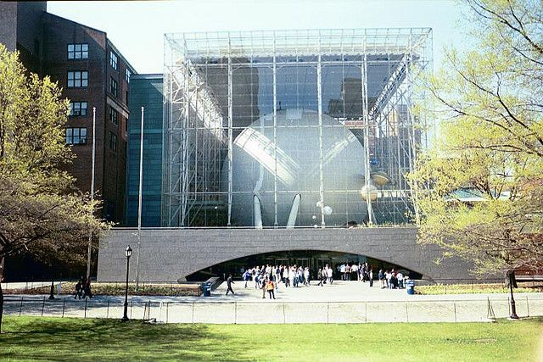

Slide 5
How does it work?
Notes:
So we need a new method of calculating distances, and we can learn a lesson from our own two eyes, or our stereo vision.

Slide 6
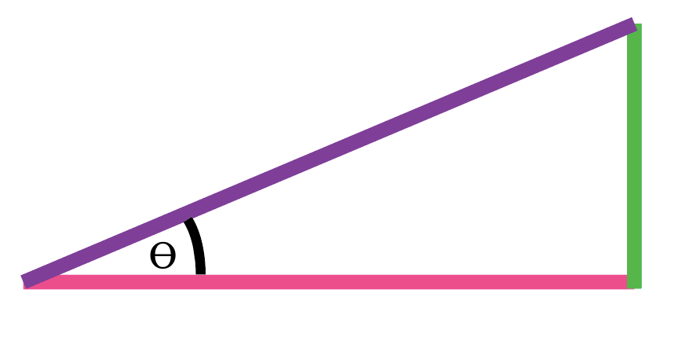

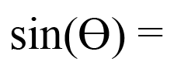
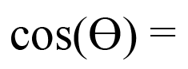
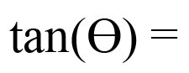
Right Triangle Relationships
HYPOTENUSE
OPPOSITE
ADJACENT
O
A
O
H
H
A
SOH
CAH
TOA
Notes:
Does anyone notice anything special about this triangle? If I draw this, does it help? That’s right, it’s a right triangle! (pun intended). Right triangles are fun because if we know just two parts of the triangle, we can figure out the others. We’ll start by labeling the sides of our triangle. Then we can make these relationships between the sides and our angle theta. Sine of theta is opp over hype, cosine of theta is adj over hype and tangent of theta is opp over adj. While these words may sound new, they just describe the ratio of two sides of the triangle. We can remember them by this mnemonic.

Slide 7
Using a right triangle, we can figure out the length of any side with only an angle and another side!
Notes:
So we need a new method of calculating distances, and we can learn a lesson from our own two eyes, or our stereo vision.

Slide 8
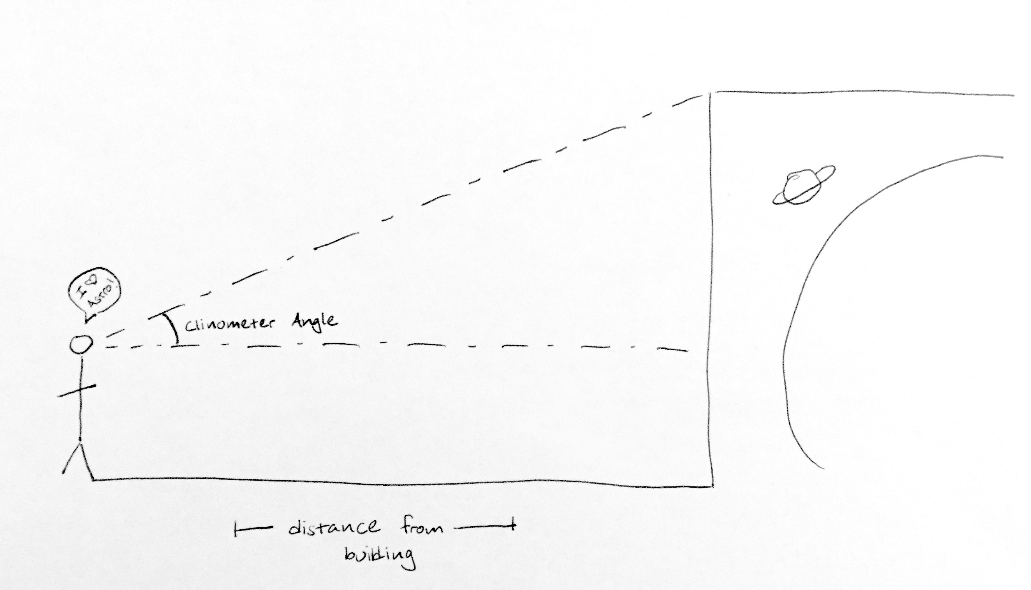
HYPOTENUSE
OPOSITE
ADJACENT
Notes:
We will measure two things, our distance from the planetarium, and the angle we see with our clinometers. Let’s label our triangle sides and pick one of the SOH CAH TOA equations (repeat what they mean). Does anyone see any problem that this will give us with the height? Can anyone think of any measurement we can make to fix this?

Slide 9
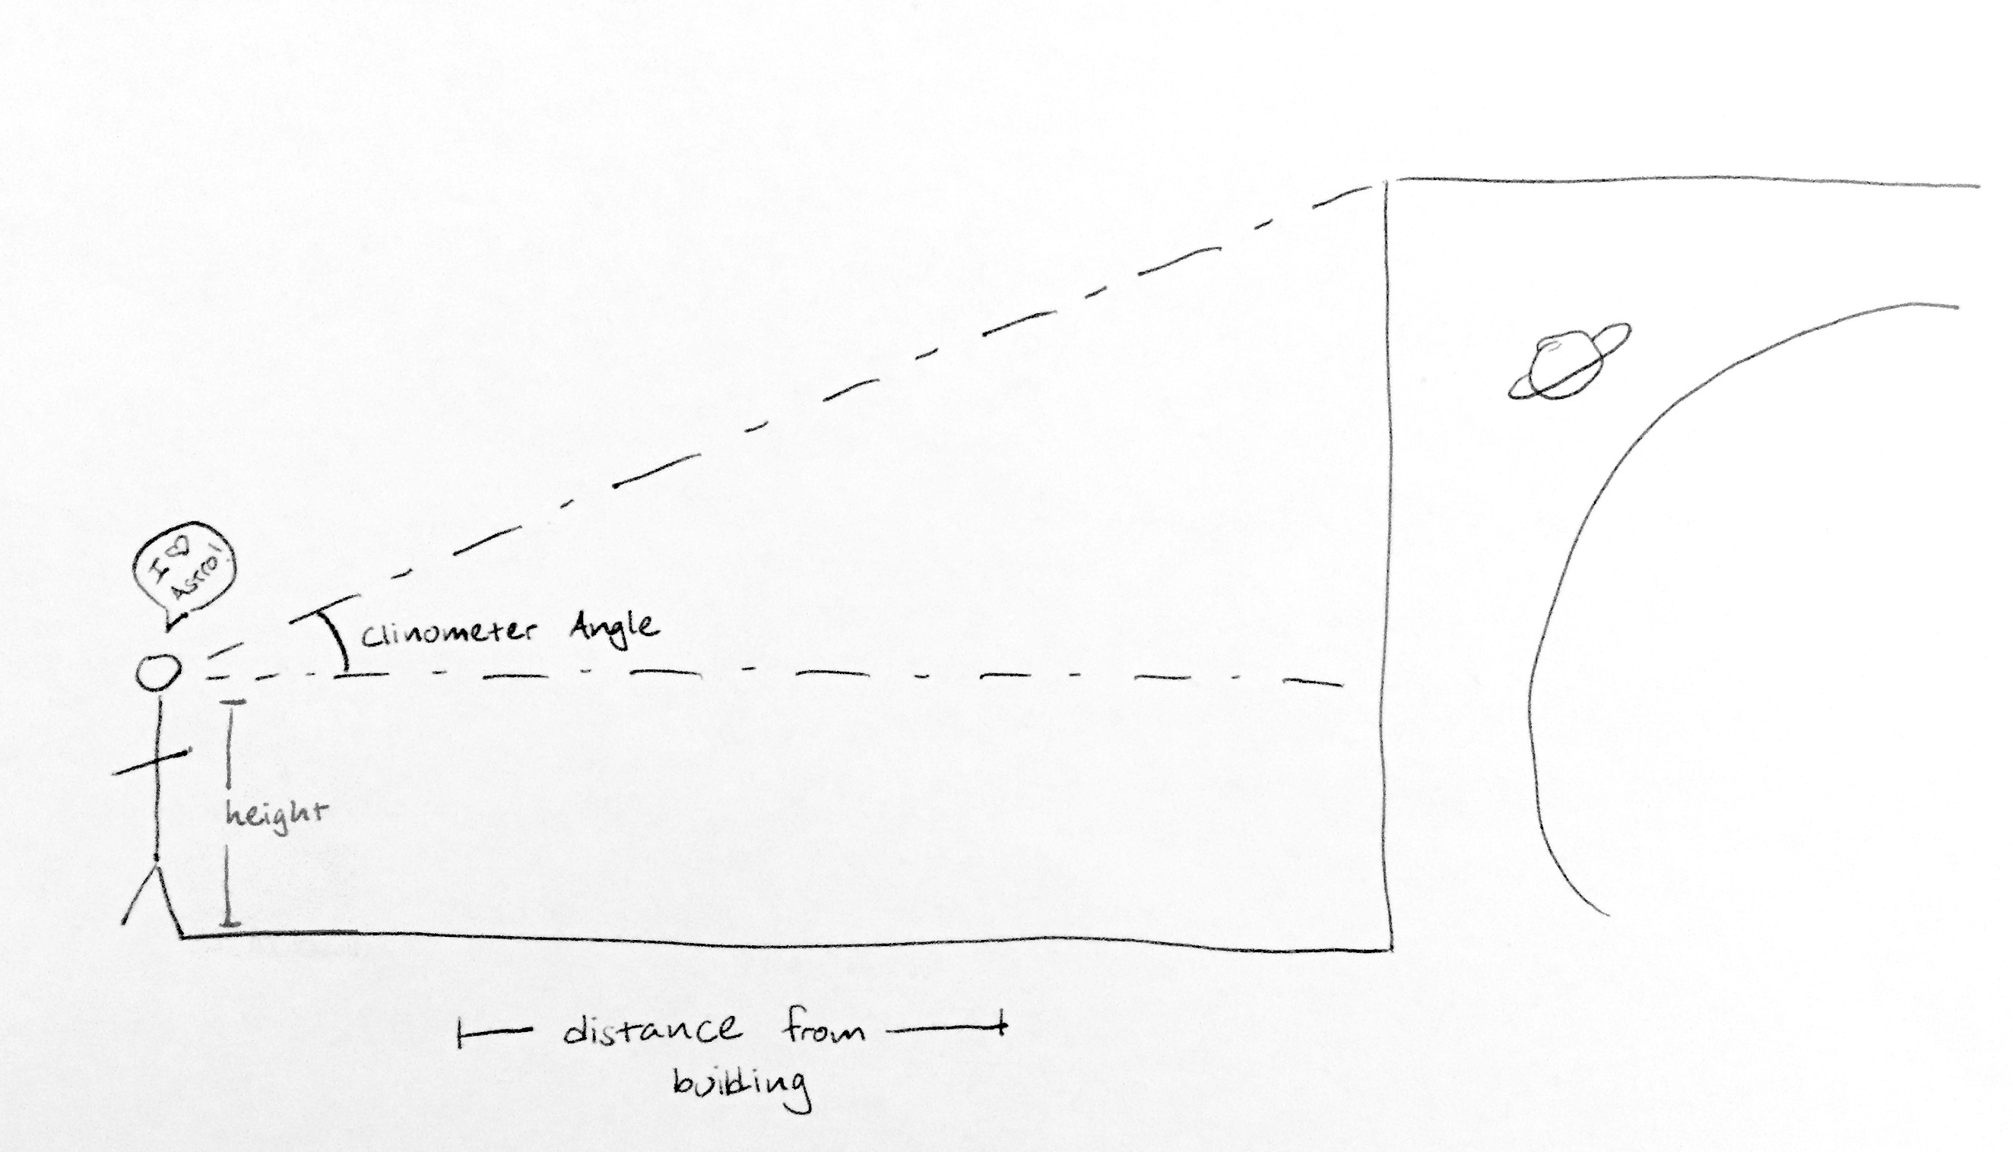
Notes:
We can fix it by measuring the height to our eyes! We can then add this measurement to the other measurement we made with our right triangle to know the height of the Hayden Planetarium!

Slide 10
What does this have to do with astrophysics?
Notes:
So we need a new method of calculating distances, and we can learn a lesson from our own two eyes, or our stereo vision.

Slide 11
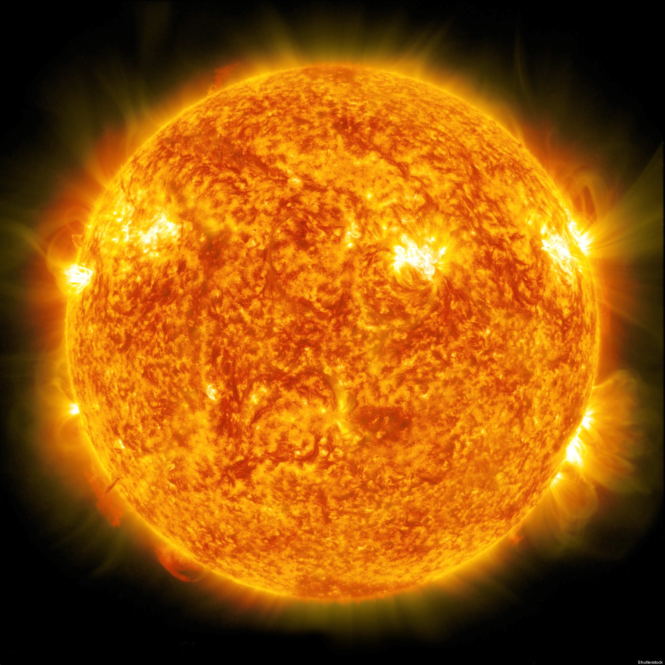
Relative Brightness
Absolute Brightness
Notes:
This allows us to do something cool! Since we have the sun nearby, we know how bright it’s supposed to be when we are 1 earth distance away. We can use this knowledge to compare how much brightness, or how much light intensity, we see from from each star to how much light intensity it actually should have. Since this change in intensity is proportional to distance, or since this exact change in intensity only happens at a specific distance, we can calculate how far the star is from its brightness!

Slide 12
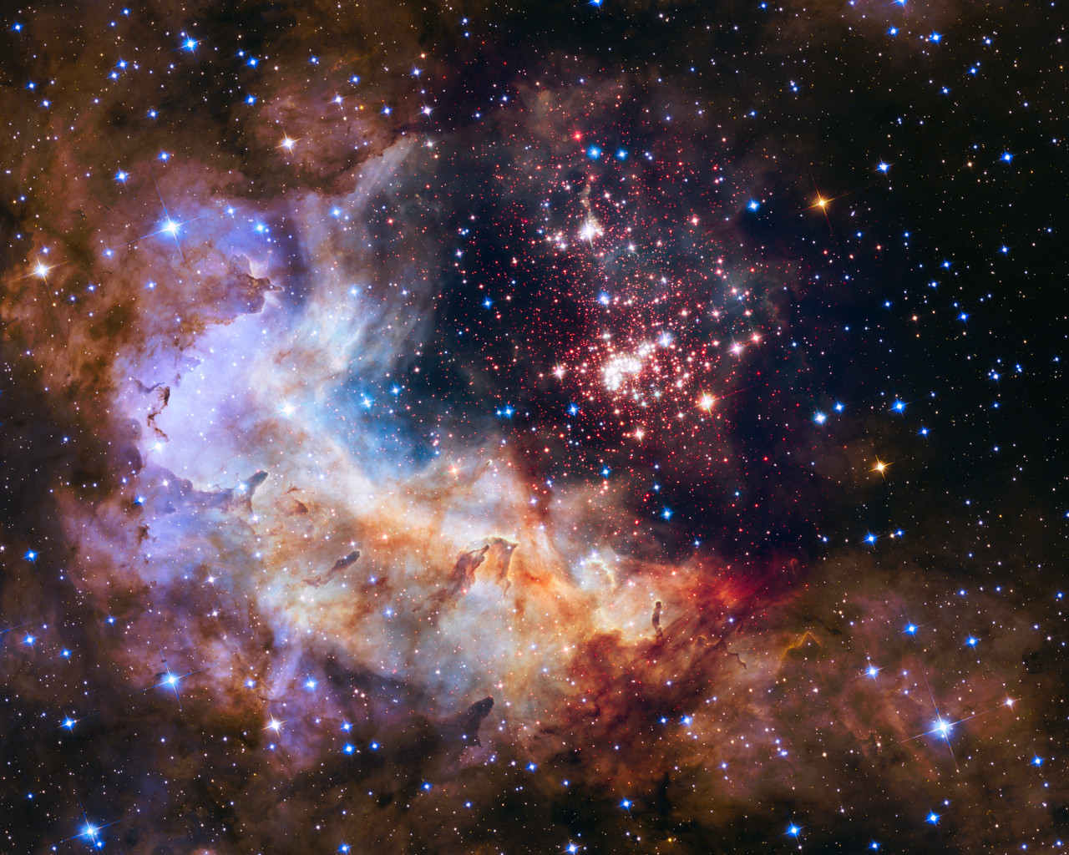
#nofilter
Notes:
Does anyone know where pictures like these come from? (Yes, they are real, no photoshopping here!) Do you think all of these stars are exactly like the sun?

Slide 13
What if some stars far away are naturally less bright than the sun? Or more bright?
Notes:
So we need a new method of calculating distances, and we can learn a lesson from our own two eyes, or our stereo vision.

Slide 14



Notes:
Parallax experiment with fingers in front of eyes. Students can hold two fingers in front of their nose, in front of this screen. One should be close by and one should be as far as their hand stretches, right near the screen. They can compare how much their fingers move relative to the colors.

Slide 15
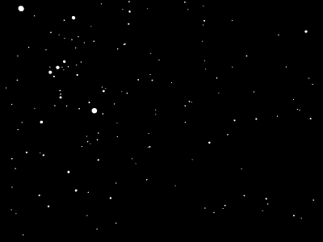
Notes:
But what do our fingers in front of the screens have to do with tracking the distance to stars? Take a look at the stars in this video. What do you notice about them as we move through the year? Are some of them moving? Are some of them staying in the same place? Which ones do you think are closer? If we think about the activity we just did, with the nearby finger and farther finger appearing or not appearing to move, would you change your mind about which ones are closer?
Backup link: http://astro.physics.uiowa.edu/ITU/_Media/parallax_animation.gif

Slide 16
Notes:
We’re going to watch this video again, and let’s pay attention to the motion of the closer stars. Do they seem to make a certain shape on the sky? Why do you think they make that circular shape over the course of a year?
Backup link: http://astro.physics.uiowa.edu/ITU/_Media/parallax_animation.gif

Slide 17
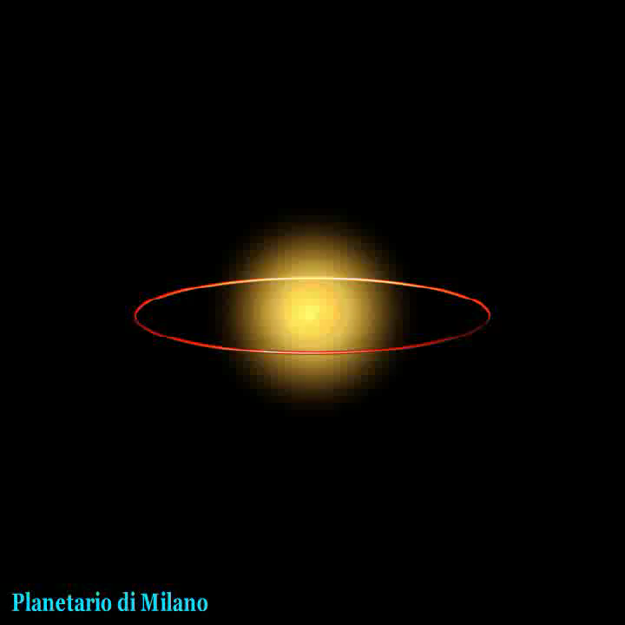
Notes:
This video starts off with earth orbiting around the sun over the course of a year. What happens when we look at a nearby star over the course of one solar year, or one full orbit around the sun? Similarly to when we viewed our nearby fingers on the colored screen, the apparent position of the star seems to change compared to far away stars, just like when we compared our closer finger to our farther away fingers. This apparent position change moves in an elliptical, or circular motion, because we move in an elliptical orbit around the sun.

Slide 18
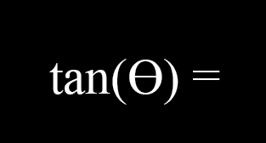
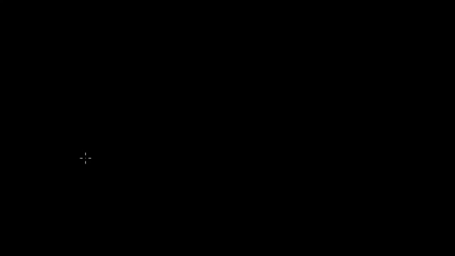
O
A
O
A
O
A
Notes:
Great! So you might be wondering what this has to do with triangles, and that is a great question! Here in this video let’s work through the connection. Pause after he draws the second observation after six month. Look! We’re finally getting to the triangles! But… there’s a problem with these triangles, and do you see what it is? They aren’t right triangles. We can fix that though, let’s keep watching to see how. Pause when he starts talking telescope angle. What does he mean by telescope angle? Use my water bottle as a sample telescope to show the change in angle between 0 and 90 degrees. Continue video. How? Well, let’s think back to our right angle relationships: SOH CAH TOA. What is it that we know here? We know the angle we moved our telescope and we know 1 AU (93 million miles). What we’re missing is the line from the sun to the star. Let’s figure out which relationship that is. We have angle and opposite, we need adjacent. Does anyone remember which relationship has both adjacent and opposite? (Repeat them out loud.) Tangent does! So let’s do that math to figure out the distance. Piece in the math pieces.

Slide 19
Using Parallax
Distance to Sun
Distance to Star =
Parallax Angle
1 AU
d =
p
Notes:
This actually gives us a much easier to calculate equation! Here is the parallax equation, which tells us if we know the distance to the sun, which we do, and the parallax angle, which we get by looking at a star 6 months apart and drawing those triangles, then we can calculate the exact distance to a star.

Slide 20
Parallax allows us to find out how far a star is, without knowing its brightness!
Notes:
This is particularly exciting, because by looking at a star multiple times throughout the year (and who doesn’t want to do that!) we can calculate how far away a star is without knowing it’s brightness, relative or absolute! All we need is for it to be there and to not disappear over 6 months.

Slide 21
We Learned…
Nearby stars appear to move when compared to faraway stars because of our orbit around the sun.
Using right triangle relationships, we can figure out the length of a side with only an angle and another side.
We can create a right triangle between us, the sun and a star to calculate the parallax distance of a star.
The “motion” of nearby stars allows us to calculate distances using parallax regardless of brightness!

Slide 22
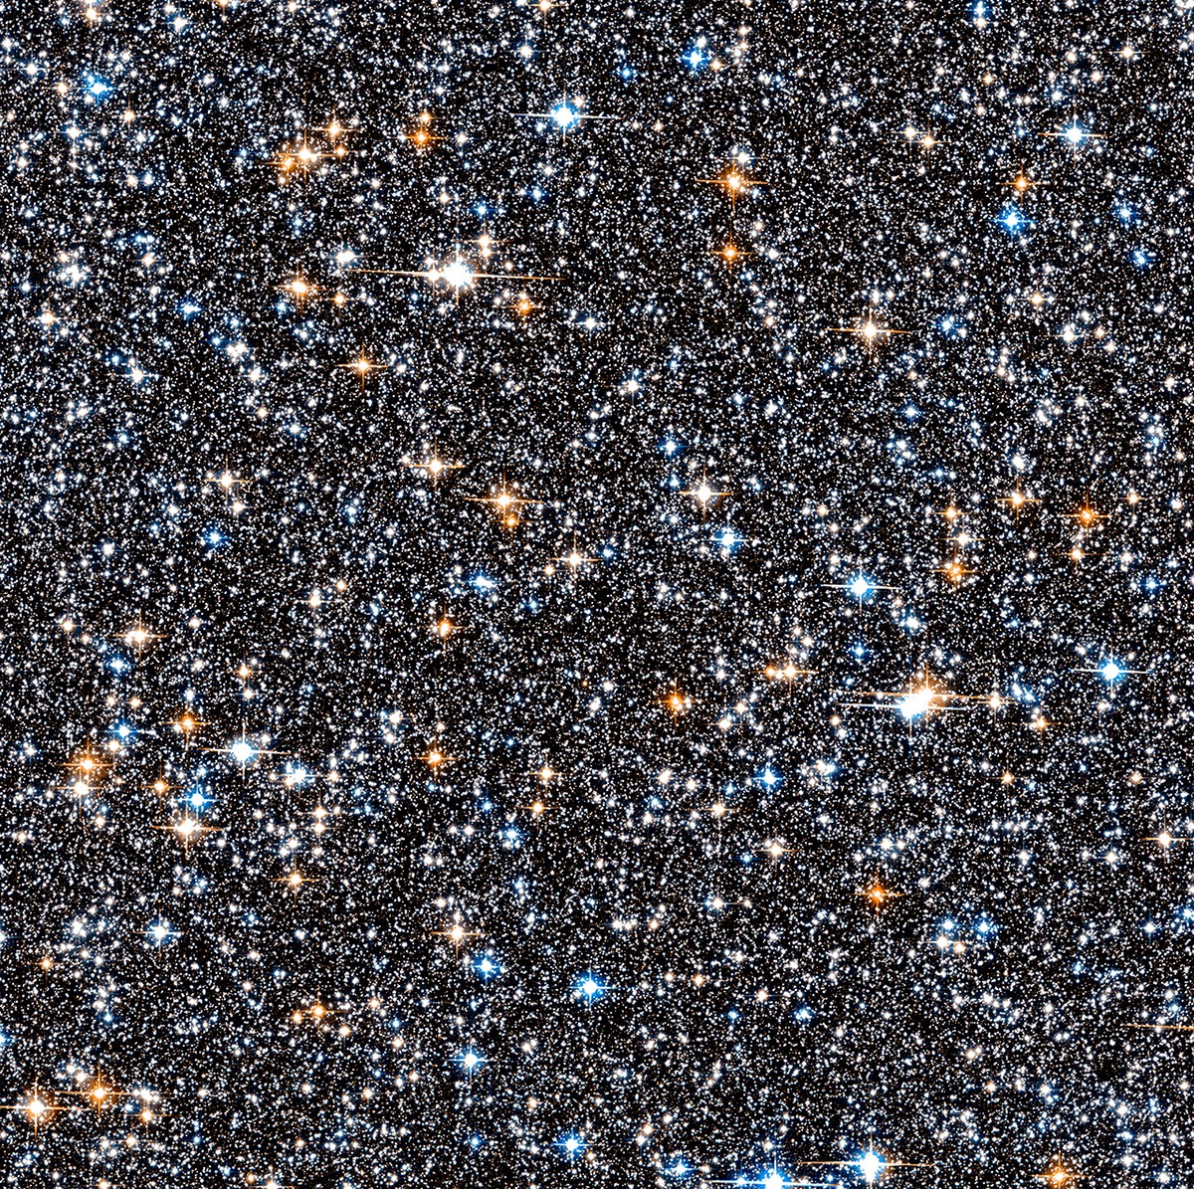
Notes:
Do you think all these stars are the same distance, different distances, or a mixture?

Slide 23
Now that we know the distances to nearby stars, what do you think that will tell us about their brightness?
Notes:
This is called the brightness distance relationship.

Slide 24
What can you do with Python?
https://www.youtube.com/watch?v=oXagLBxWL44

Slide 25
Exit Tickets
Notes:
https://goo.gl/forms/4ABpDYvPi2THzcr52

